Slide 1
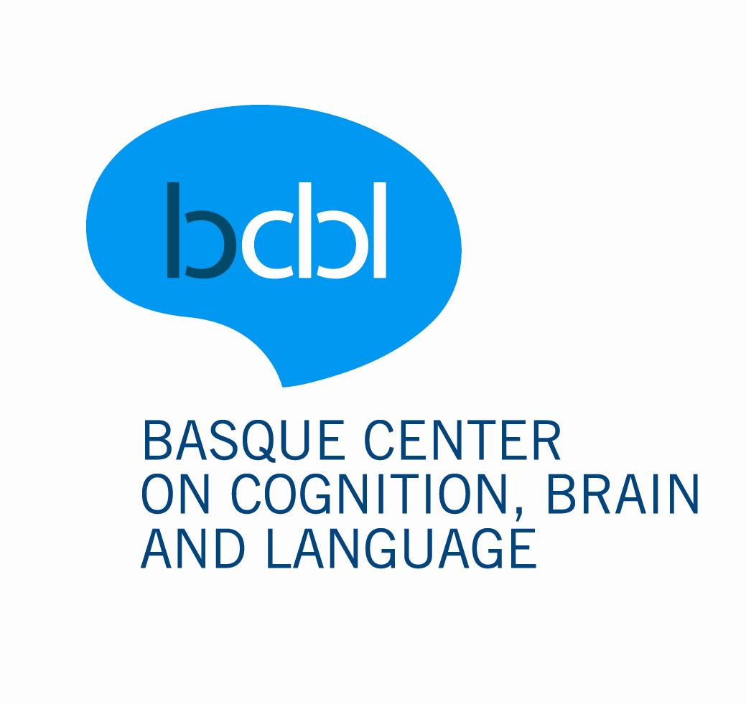

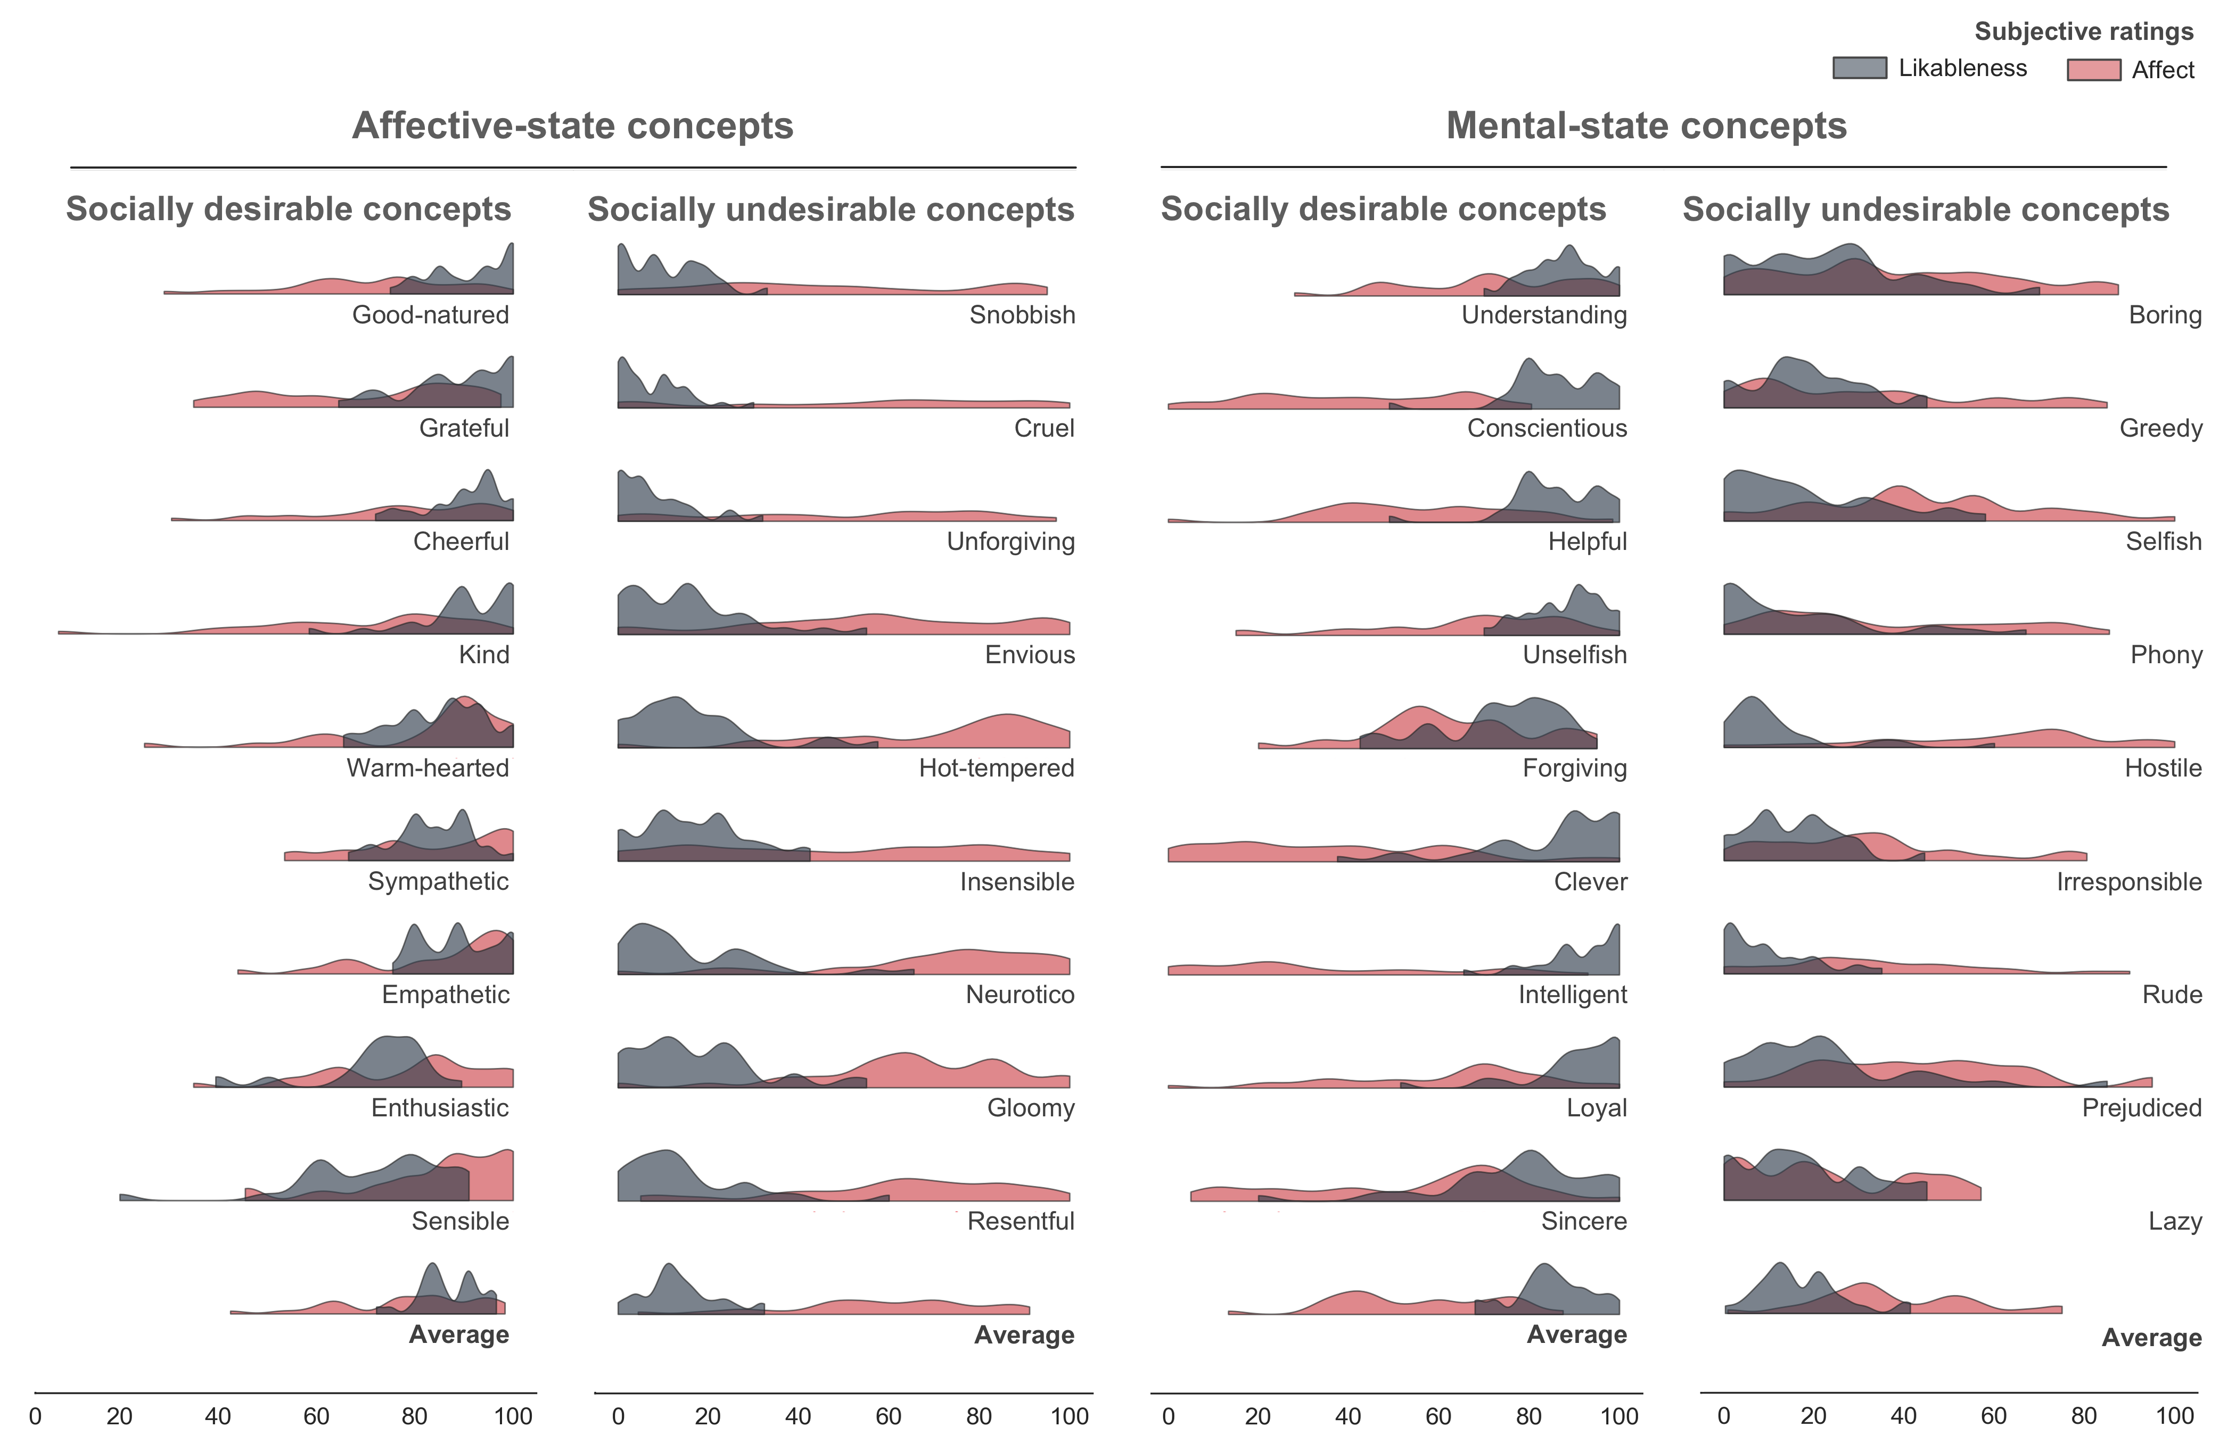

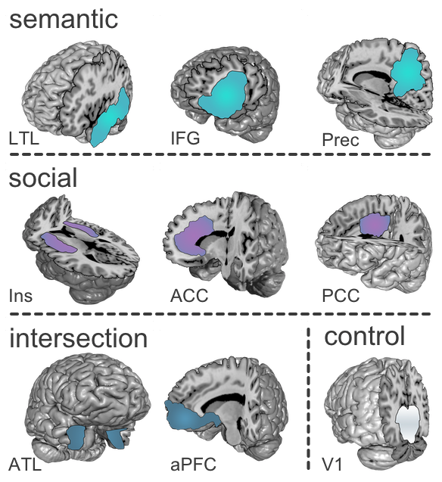
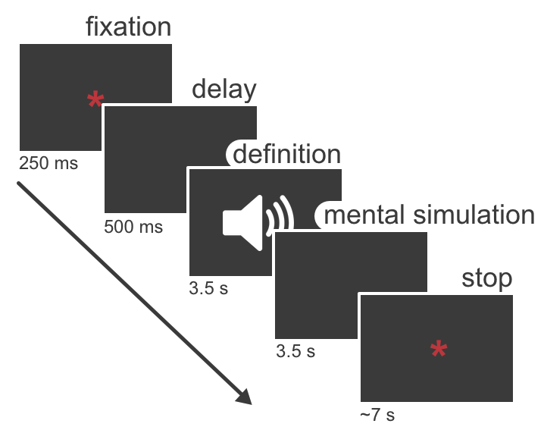
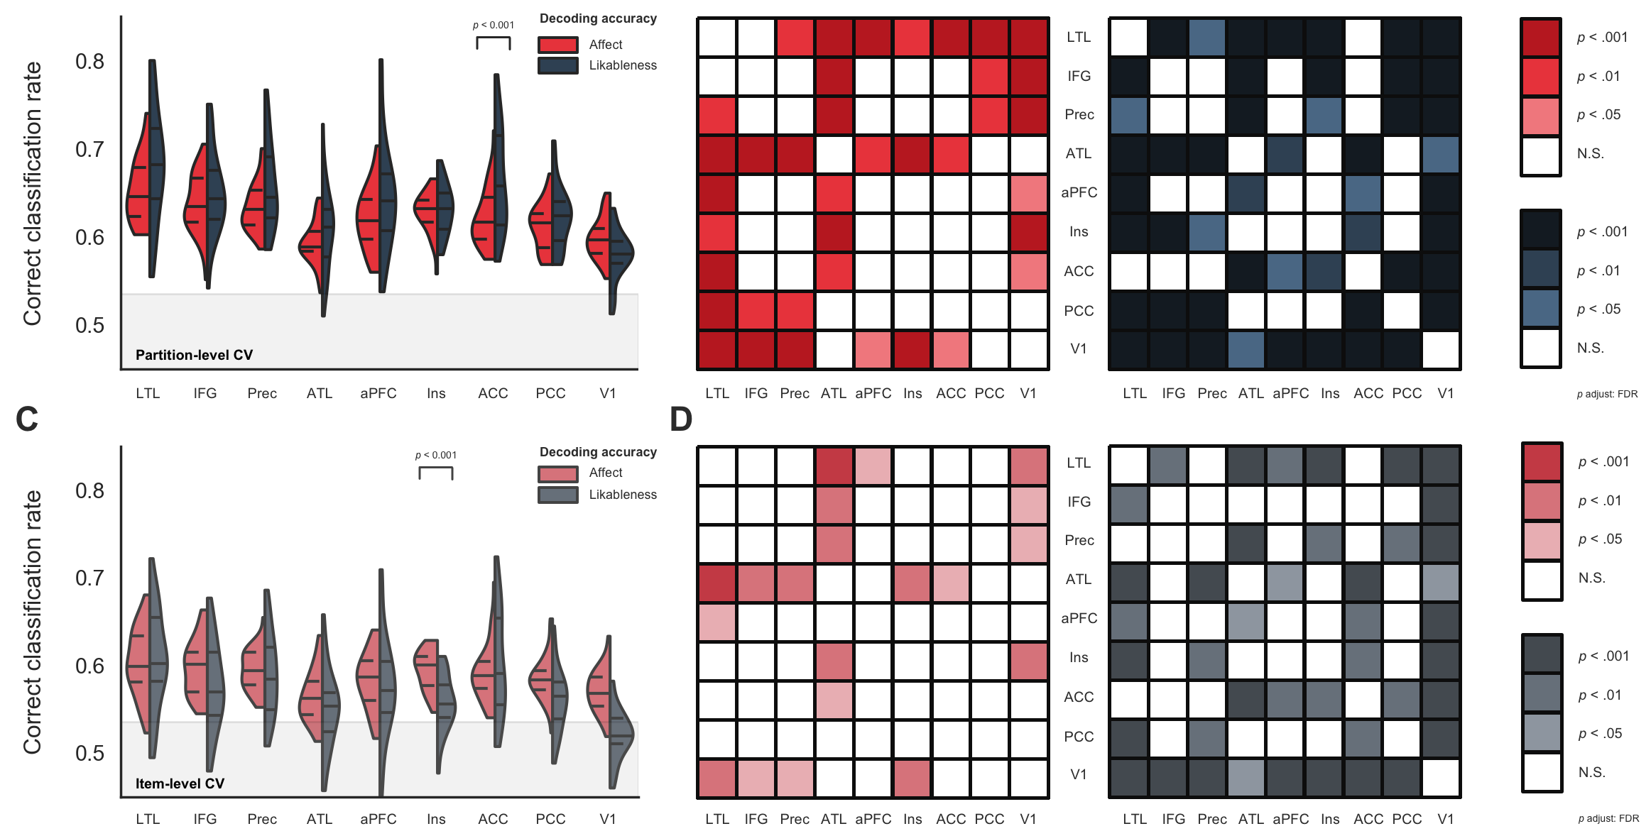
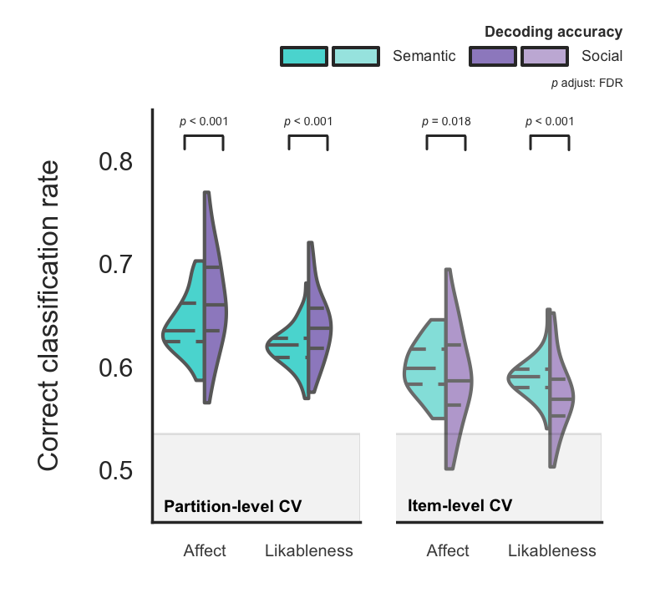

Decoding social knowledge in the human brain
d.alcala@bcbl.eu
Daniel Alcalá-López¹, David Soto^{1,2}
@danalclop
¹Basque Center on Cognition, Brain and Language (BCBL), Donostia – San Sebastian, Spain
²Ikerbasque, Basque Foundation for Science, Bilbao, Spain
Motivation
Decoding the brain representation of social concepts
Statistical analysis
How does the brain represent conceptual meaning about the attitudes, beliefs, or emotions of other people?
1
The intraclass correlation coefficient shows a fair test-retest repeatability for the ratings of affect and excellent for the ratings of likableness.
Preprocessing: (i) non-brain tissue removal (BET); (ii) volume realignment (MCFLIRT); (iii) gaussian kernel (FWHM = 3mm) for spatial smoothing; (iv) ICA-based automatic removal of motion artefacts; (v) temporal filtering (high-pass; cutoff = 60s); (vi) coalignment of each session to the 1st session.
There is extensive evidence that we can use BOLD activity to classify conceptual knowledge using a variety of concrete concepts (e.g. animals or tools; JV Haxby 2012 Neuroimage).
ID | Concept | Pre | Post | Dimension
sub-001 | Boring | 20 | 10 | likableness
sub-001 | Good-natured | 65 | 70 | likableness
sub-001 | Thankful | 81 | 72 | likableness
sub-001 | Cheerful | 95 | 80 | likableness
… | … | … | …
sub-030 | Resentful | 50 | 70 | affect
sub-030 | Sensible | 100 | 95 | affect
sub-030 | Honest | 50 | 50 | affect
sub-030 | Lazy | 10 | 0 | affect
Only recently there has been a similar interest in studying the brain representations of abstract concepts (M Ghio et al. 2016 Neuroimage; Y Wang et al. 2017 PNAS).
Classification: SVM-based linear classifier to decode the brain representation of social knowledge regarding: (i) their likableness (high vs. low) and (ii) their affect (high vs. low). We used a PCA-based feature selection within each ROI.
It is unknown how the brain maps different aspects of social information. We investigated the brain representations of social knowledge associated with two fundamental processes in social cognition: affect and likableness (NH Anderson 1968 J Pers Soc Psychol).
Cross-validation: (i) we used partitions of the stacked BOLD data as left-out samples to test the classifier. (ii) we also used entire items (i.e. concepts) as left-out sample for testing to better ensure out-of-sample generalization.
ICC_{affect} = 0’47 [0,36-0,60]
Chance level: we trained a classifier on samples with randomly shuffled labels and tested on samples labelled appropriately to empirically estimate chance level performance and used paired t-tests to assess statistical significance.
This fMRI study investigated the representation of abstract social concepts in the human brain using multivariate pattern analysis (MVPA).
ICC_{likableness} = 0’93 [0,89-0,96]
2
Ratings of affect (red) of concepts related to affective states were significantly higher than those related to non-affective mental states
(t₍₂₉₎ = 8.026, p < 0.001, d = 1.465) and ratings of likableness (grey)
of socially likable concepts were significantly higher than those of
socially unlikable concepts (t₍₂₉₎ = 30.382, p < 0.001, d = 5.547).
Statistical significance: decoding performance at the group level was estimated with (i) two repeated-measures ANOVAs with one factor (ROI) to compare ROIs; (ii) with a repeated-measures ANOVA with two factors (ROI and affect vs. likableness) to analyse whether some ROIs were biased towards decoding the affect or likableness; and (iii) paired t-tests to compare the average decoding accuracy in semantic ROIs compared with social ROIs.
Experiment
3
Subjective ratings suggest that the likableness of others’ behavior can outweigh affect on how we represent social knowledge.
Participants (n = 30; mean age 24.07 ± 3.67 years; 18 females) rated on a scale from 0 to 100 how likable and affective was each social concept before and after the scanning session.
Repeated-measures ANOVAs with one factor (ROI) showed significant differences in decoding accuracy among ROIs for each classification problem (affect vs. likableness).
Regions of interest: based on previous studies on semantic (JR Binder et al. 2009 Cereb Cortex) and social information processing (D Alcalá-López et al. 2017 Cereb Cortex):
4
Figure 1. Distribution of ratings of social concepts. Participants read each concept definition and rated whether they described a behaviour involving the emotions of oneself or others (affect; red) as well as whether such behaviour was socially likable(grey) on a scale from 0 (very nonaffective; very unlikable) to 100 (very affective; very likable).
During the fMRI session, participants listened to short definitions of social concepts and mentally simulated another individual behaving the way described in the definition:
+ 3 semantic regions (lateral temporal lobe, LTL; inferior frontal gyrus, IFG; and precuneus, Prec)
 |  | Sum of Squares | df | Mean Square | F | p | ω²
Partition CV | Affect | 0.086 | 8 | 0.011 | 19.505 | < .001 | 0.244
 | Likableness | 0.240 | 8 | 0.030 | 30.888 | < .001 | 0.267
Item CV | Affect | 0.040 | 8 | 0.005 | 8.195 | < .001 | 0.240
 | Likableness | 0.176 | 8 | 0.038 | 23.531 | < .001 | 0.218
5
A repeated-measures ANOVA with two factors: ROI and dimension of social information (i.e. affect vs. likableness) showed a significant main effect of dimension for both the cross-validation procedures.
 |  | Sum of Squares | df | Mean Square | F | p | ω²
Partition CV | ROI | 0.289 | 8 | 0.036 | 39.395 | < .001 | 0.314
 | Dimension | 0.034 | 1 | 0.034 | 7.801 | 0.009 | 0.054
 | ROI * Dimension | 0.037 | 8 | 0.005 | 7.640 | < .001 | 0.056
Item CV | ROI | 0.171 | 8 | 0.033 | 27.657 | < .001 | 0.334
 | Dimension | 0.033 | 1 | 0.033 | 2.938 | 0.097 | 0.043
 | ROI * Dimension | 0.045 | 8 | 0.009 | 7.281 | < .001 | 0.105
“She can reason, solve problems and understand complex ideas”
+ 3 social regions (insula, Ins;
anterior cingulate cortex, ACC;
posterior cingulate cortex, PCC)
+ 2 semantic & social regions
(anterior temporal lobe, ATL;
anterior prefrontal cortex, aPFC)
6
Post hoc paired t-tests showed that the interaction effect was driven by the ACC (t₍₂₉₎ = 4.461, p = 0.001, d = 0.814), with a preference for likableness when using the partition-level CV. On the other hand, the effect was driven by the Ins (t₍₂₉₎ = -4.623, p = 0.001, d = 0.844), with a preference for affect instead when using the item-level CV.
+ 1 control region (primary visual cortex, V1)
Take-home messages
7
Paired t-tests showed that mean classification accuracy was significantly higher in semantic ROIs for both affect (t₍₂₉₎ = 5.590, p < .001, d = 1.021) and likableness (t₍₂₉₎ = 5.113, p < .001, d = 0.933) using partition-level cross-validation. Similarly, mean decoding accuracy was higher in semantic ROIs for both affect (t₍₂₉₎ = 2.519, p = 0.018, d = 0.460) and likableness (t₍₂₉₎ = 4.133, p < .001, d = 0.755) using item-level cross-validation.
While previous evidence have analysed temporal correlations between the time series of different ROIs, here we used a pattern classification approach showing these distributed ROIs actually contain information relevant to distinct aspects of social knowledge, beyond just showing activation related to the processing of social information.
A scanning session consisted on 8 functional runs and a structural run halfway through the session.
Our results don’t support a modular view of the representation of social concepts. Rather, they are consistent with the idea that socially relevant knowledge relies on a widely distributed brain network.
Each functional run contained 36 trials (one trial per social concept; 9 concepts for each concept class). A trial consisted on the auditory presentation of the definition of the social concept for 3.5 seconds followed by another short period of 3.5 seconds to mentally simulate the referred behavior.
Figure 3. Decoding accuracy of social concepts in semantic vs. social ROIs. Comparison of average decoding accuracy in semantic ROIs with social ROIs using both the partition- and item-level CV procedures. The shaded area indicates the mean empirically estimated chance level (mean = 0.53).
Alcalá-López, D., Smallwood, J., Jefferies, E., Van Overwalle, F., Vogeley, K., Mars, R. B., ... & Bzdok, D. (2017). Computing the social brain connectome across systems and states. Cerebral cortex, 28(7), 2207-2232. | Anderson, N. H. (1968). Likableness ratings of 555 personality-trait words. Journal of personality and social psychology, 9(3), 272. | Binder, J. R., Desai, R. H., Graves, W. W., & Conant, L. L. (2009). Where is the semantic system? A critical review and meta-analysis of 120 functional neuroimaging studies. Cerebral Cortex, 19(12), 2767-2796. | Haxby, J. V. (2012). Multivariate pattern analysis of fMRI: the early beginnings. Neuroimage, 62(2), 852-855. | Ghio, M., Vaghi, M. M. S., Perani, D., & Tettamanti, M. (2016). Decoding the neural representation of fine-grained conceptual categories. Neuroimage, 132, 93-103. | Wang, Y., Collins, J. A., Koski, J., Nugiel, T., Metoki, A., & Olson, I. R. (2017). Dynamic neural architecture for social knowledge retrieval. Proceedings of the National Academy of Sciences, 114(16), E3305-E3314.
Figure 2. Decoding accuracies of social concepts across the brain. Classification accuracy of both the affect and likableness of social knowledge using partition-level (A) as well as item-level (C) cross-validation procedures. Panels (B) and (D) show post hoc paired t-tests of separate repeated-measures ANOVAs with one factor (ROI) for affect (red) and likableness (grey) for both CV procedures.

